Slide 1
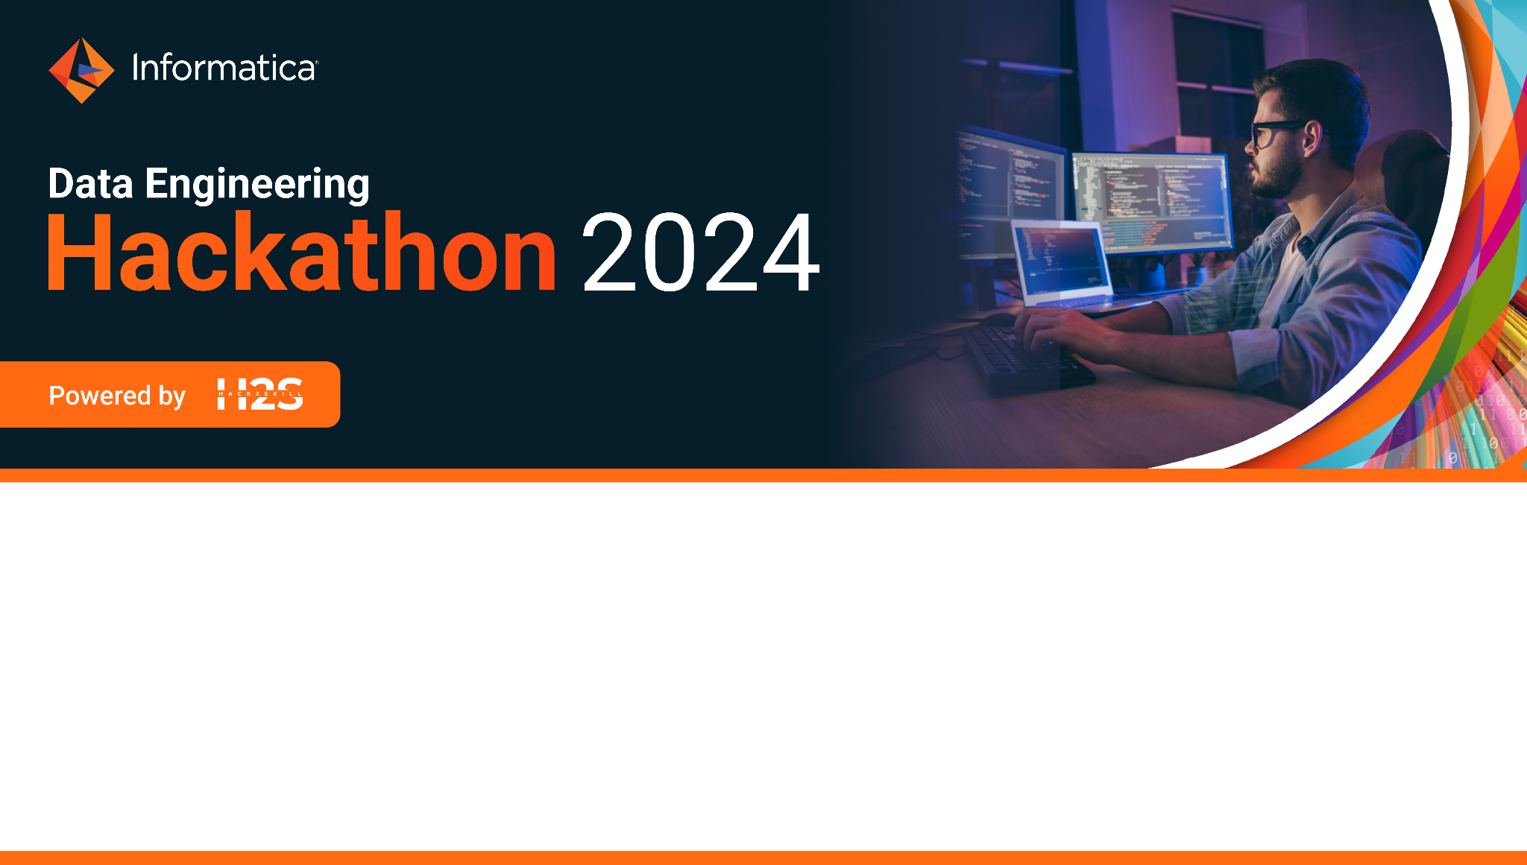
Team Name: base234
Team Size: 4
Team Member Names: Arnab Das, Sayan Sinha, Jayita Bhattacharyya, Debankita Dutta
Problem Statement: AI/ML and Data Science
Problem Statement Theme: Healthcare Diagnosis

Slide 2
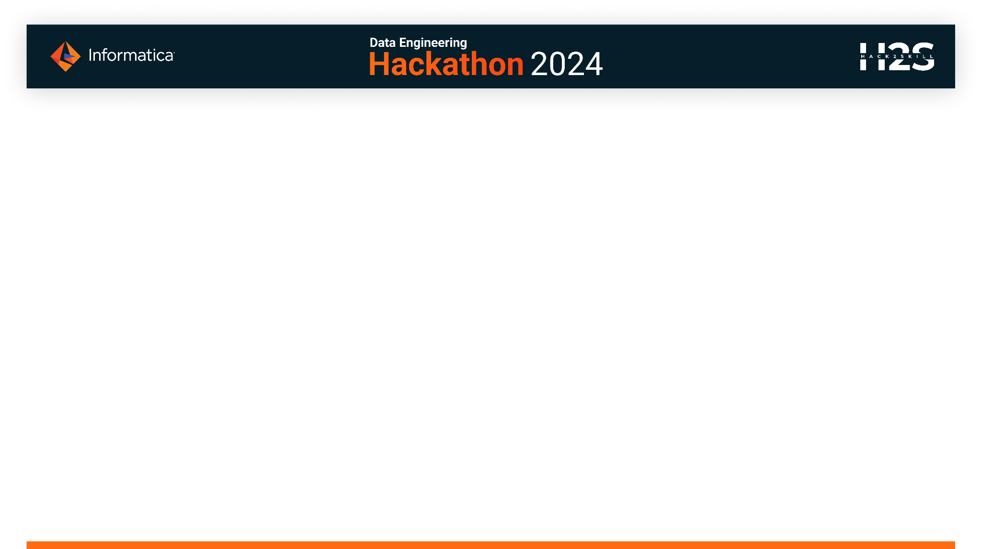
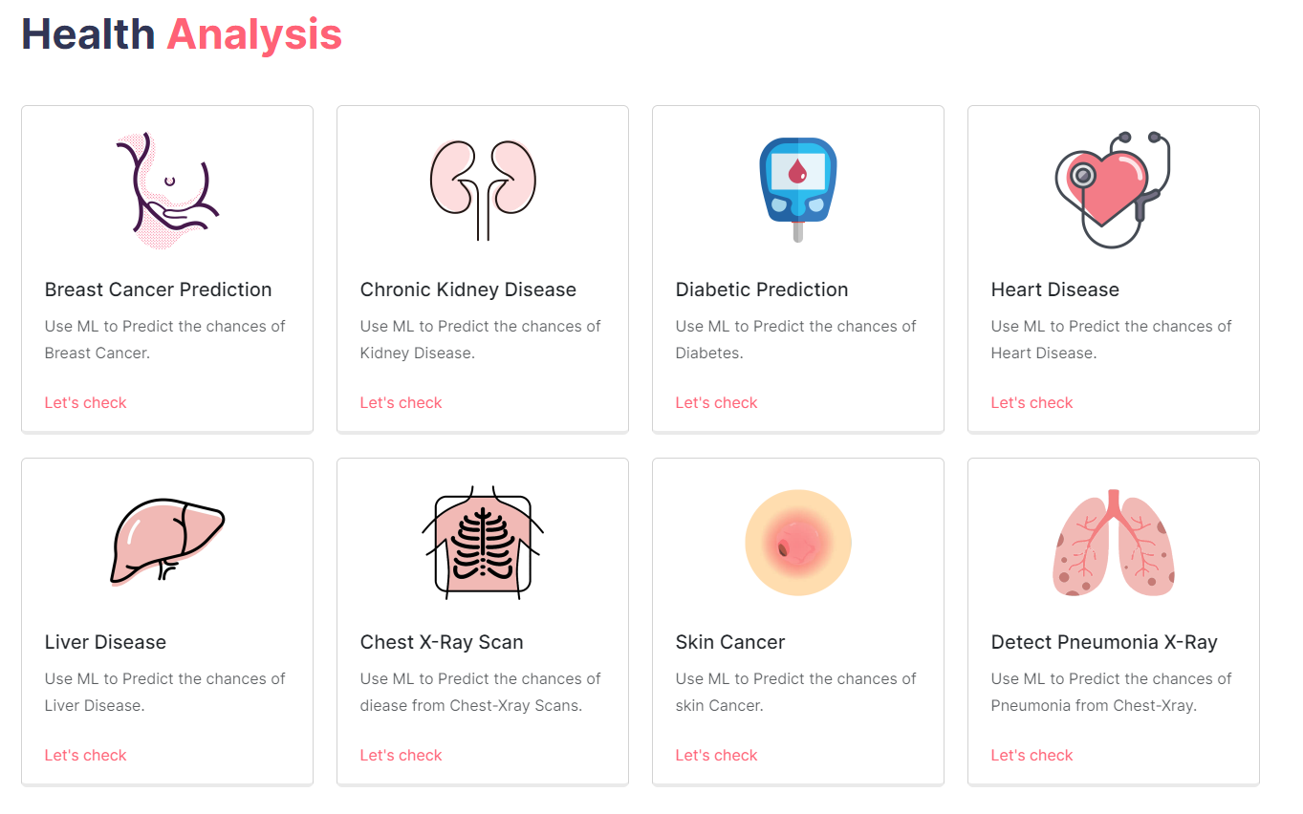
Idea Brief
Hitaya is a one-stop solution, a medical diagnosis App that can allow users to upload medical data or x-ray scans, and the APP will predict whether a patient has any disease or not.
Machine Learning has been revolutionizing on healthcare domain. ML models can now detect patterns underlying diseases. In this way, AI techniques can be considered as the second pair of eyes for doctors, that can decode patient health knowledge extracted from large data sets by summing up facts & observations of diseases.
Features
Creating an AI/ML preliminary diagnosis application.
Users/Doctors can input images of x-ray scans/ medical data/ or just images and our Application will give them the diagnosis results.
Using Generative AI to give user health Recommendations or Provide Diet Plans.
Diagnostic System to predict the risk of a disease based on user data.
Using Informatica create an ML pipeline that will re-train ML models from new data and upload the models using Model Serve for our UI to consume.

Slide 3
Tech Stack
Flask
React
Informatica
Snowflake
Machine Learning (Pytorch, scikit-learn, Tensorflow)
Node.js

Slide 4
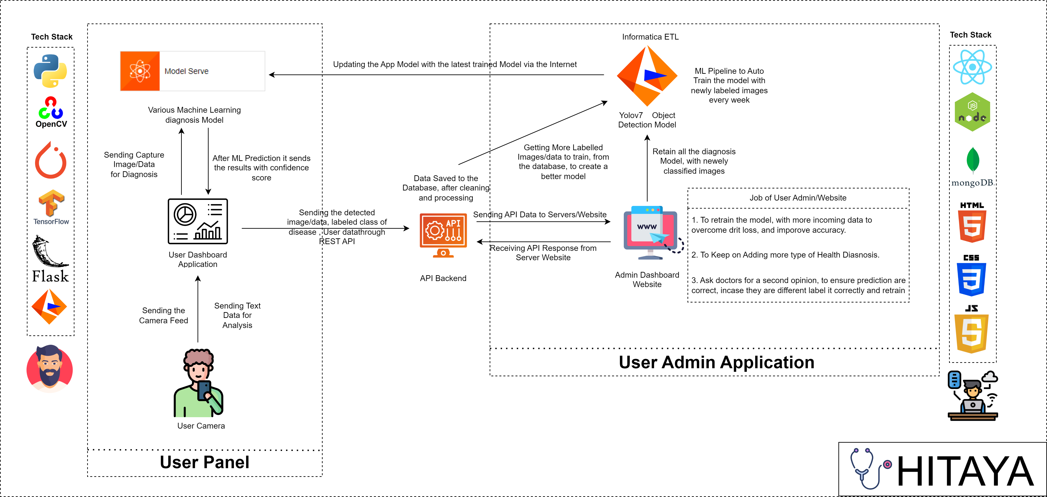
Project Architecture

Slide 5
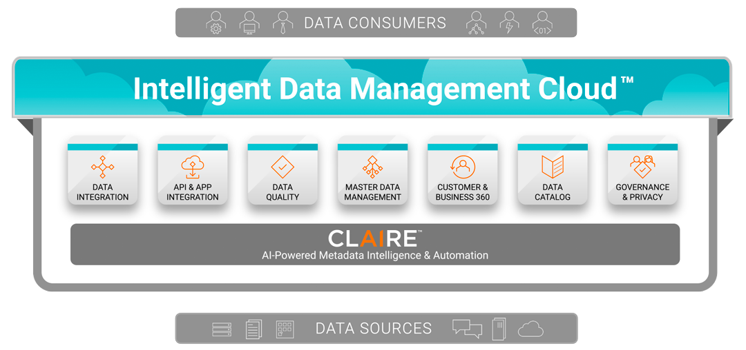
What positive and unique solutions your Idea have?
With Informatica’s Intelligent Data Management Cloud, all these services are available to natively on a cloud-first, microservices-based, API-driven platform that’s both elastic and serverless. CLAIRE, AI technology, is embedded in every service. Data can be brought from any source, of any type, to serve any user anywhere.

Slide 6
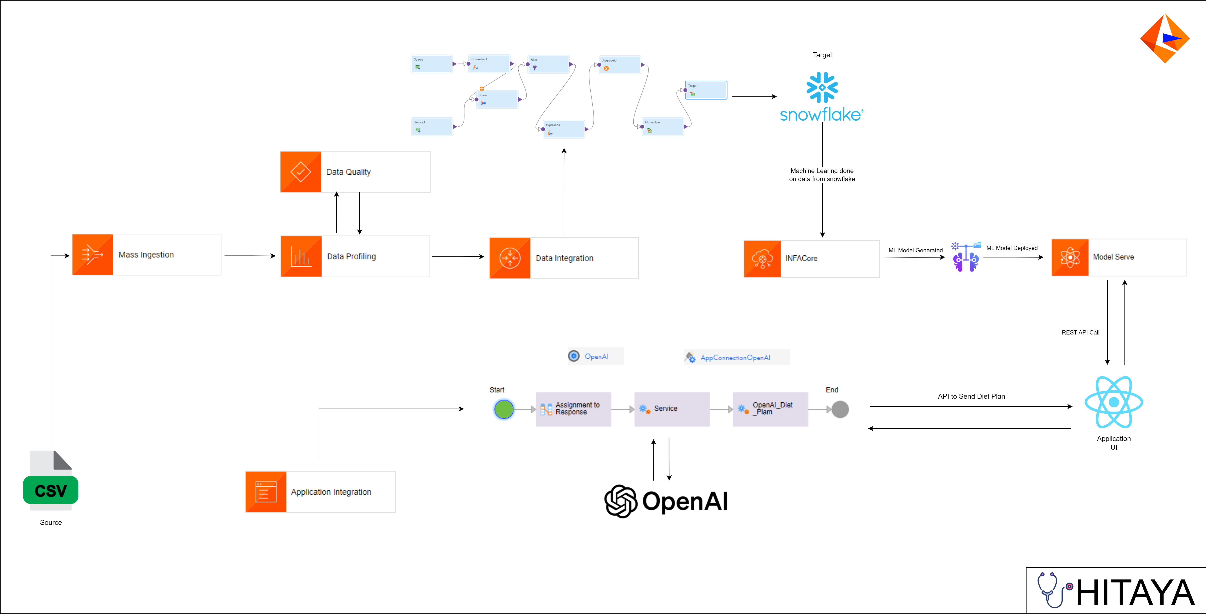
Project Architecture Informatica

Slide 7
Creating a machine learning (ML) pipeline for training disease diagnosis data from Snowflake using Informatica INFACore involves several steps. Here’s a high-level overview of the process:
Data Collection: Open Source and readily available data is collected from various sources. This primarily contains patients historical data on large scale of factors influencing a particular disease. The data is saved into CSV as Flat files and ingested to Informatica Mass Ingestion.
Data Processing: Clean and preprocess the data using Informatica’s, Data Profiling, Data Quality checks. This may involve normalizing data, handling missing values, and creating features that will be used for training the ML model.
Data Loading: Load the processed data into Snowflake tables using Data Integration. Ensure that the data is stored in an organized manner that’s conducive to analysis and model training.
Model Training: Utilize Informatica INFACore to read, write and use frequently available functions over pandas dataframes for model training. Made use of popular ML frameworks like scikit-learn, XGBoost, and LightGBM for training.
Model Deployment: After training, deploy your model using ModelServe. This includes managing models with Model Registry, which allows secure deployment and management of models in Informatica.
Model Inference: Leverage the deployed model through ModelServe Deployment RestAPI. This can be done by setting up a pipeline that automatically feeds new data to the model and retrieves predictions.
Monitoring and Management: Continuously monitor the performance of your ML model and manage it privileges. This includes updating the model with new data and retraining if necessary.

Slide 8

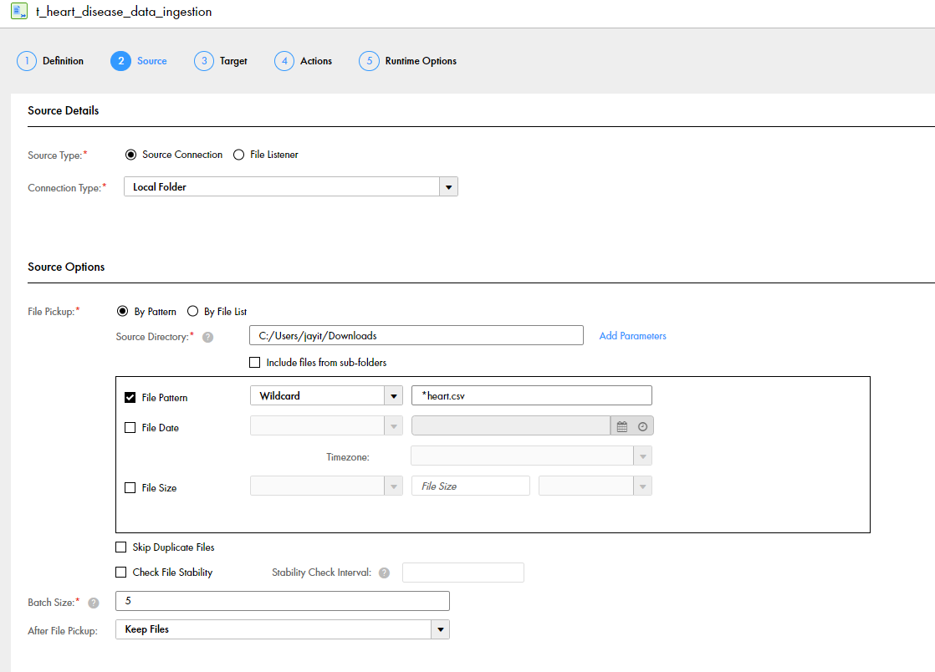
Mass ingestion involves the systematic transfer and replication of substantial volumes of data, typically between different databases or repositories, to facilitate their utilisation or storage. To efficiently manage the ingestion or replication of extensive data sets between a relational database and a Hive or HDFS target.
Here are the few bunch of csv data file for different health disease predictions which we load into the respective snowflake tables using flat file mass ingestion.
Here’s we configure the source connection pointing to the local directory of our target dataset
Here’s the target connection configuration which indicates the destination where the dataset will be finally loaded through mass ingestion and a snowflake object is being configured as the target destination
That’s how Informatica Mass Ingestion helps us to seamlessly integrate with the broader Informatica Intelligent Data Platform, allowing us to leverage additional capabilities such as data integration, data quality, metadata management, and master data management to enhance our data management processes once the data is reached to the configured target destination

Slide 9

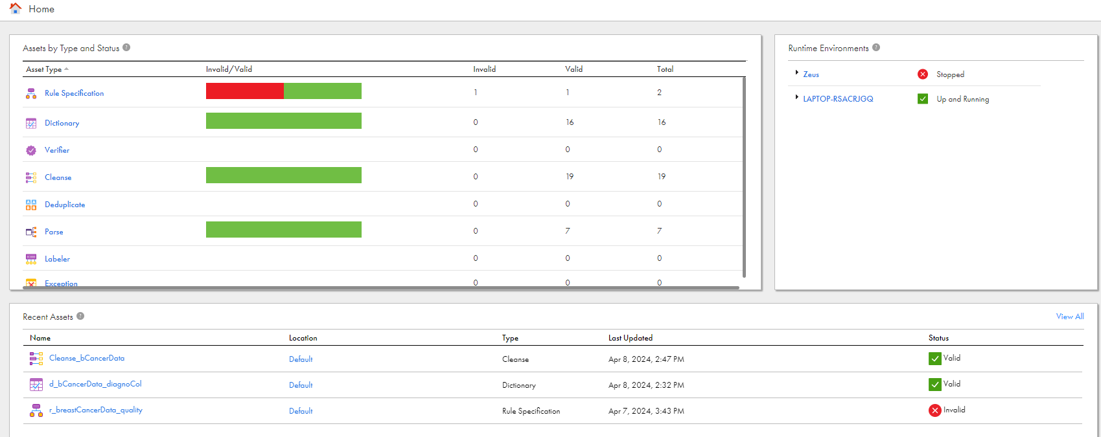
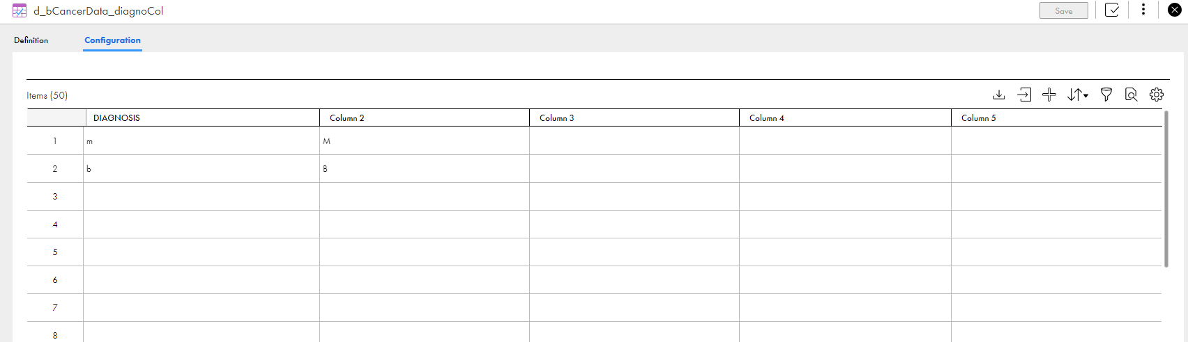
Data quality we maintain the accuracy, completeness, consistency, and reliability of data stored in sources and used for training AI Modls.
Here the data that we got from the csv dataset of breast cancer predictions ,we applied few cleansing mechanism in order to enhance the quality of the desired data
We have applied one of the predefined rules which is removing spaces from our raw dataset, so that the string type values doesn’t added with any leading or trailing spaces
Here’s a sample test_data where we performed the above rule on to check if it produces the desired result
The below output shows how it cleanse the input data and produces the expected result
Here we have standardized our data further using the dictionary where we specified the valid values of diagnosis column to M and B and whenever this column receives the data other than that it will simply standardize the data to the value set to the output column
That’s how data quality in Informatica encompasses a range of activities and capabilities aimed at improving the accuracy, completeness, and reliability of our raw_data set for different diseases.

Slide 10

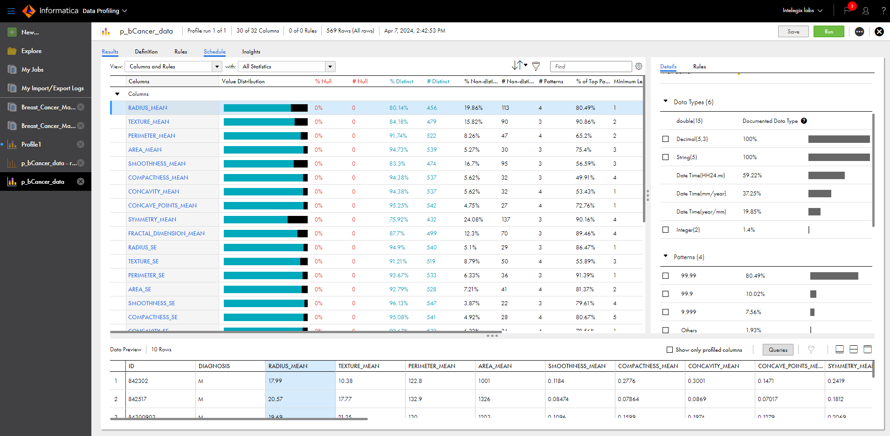
Data Profiling to assess the quality of data based on our requirements.
Analysing data to understand it’s content, structure and patterns.
Identify anomalies, inconsistencies, and potential issues in the data
Content Assessment:
Data profiling examined value frequencies, data types, and distribution.
It helped us to understand what data exists, how often it occurs, and whether it aligns with our expectations.
Structure Assessment:
Data profiling identifies keys, functional dependencies, and relationships between data elements.
It ensures that data adheres to expected structures (e.g., primary keys, foreign keys).

Slide 11

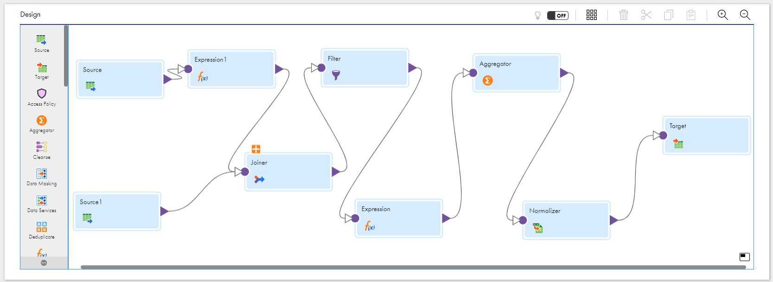
At Data Integration we have combined Data from Different Sources and streamlined it to upload it to Snowflake Data Warehouse.
Joiner: joined data form different sources.
Filter: Filter data from the sequence flow.
Expressions: Performed calculation on individual rows of data.
Aggregator: Performed aggregate on our data.
Normalizer: normalised the data.

Slide 12

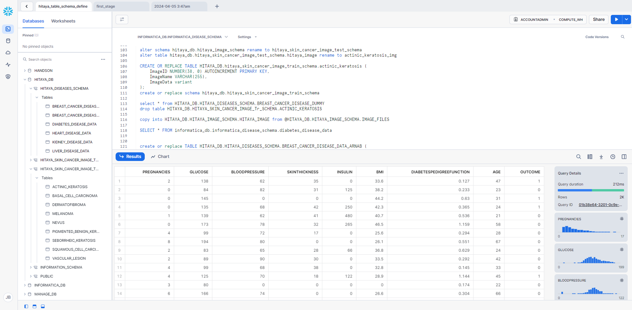
IDMC provides a Snowflake cloud Connector, which allows us to integrate Snowflake with IDMC workflows. We used this connector to extract, transform, and load (ETL) data IDMC to load source data from databases, applications, and data files in the cloud or on-premises into Snowflake.
First of all we configured a snowflake connection to our IDMC data platform by specifying the account Name, credentials, warehouse and runtime environment .
Then we created a mapping to read comma delimited csv files from local, and write the results into the respective tables in Snowflake. This dataset for diabetes predictions is now loaded to its respective table in snowflake.

Slide 13

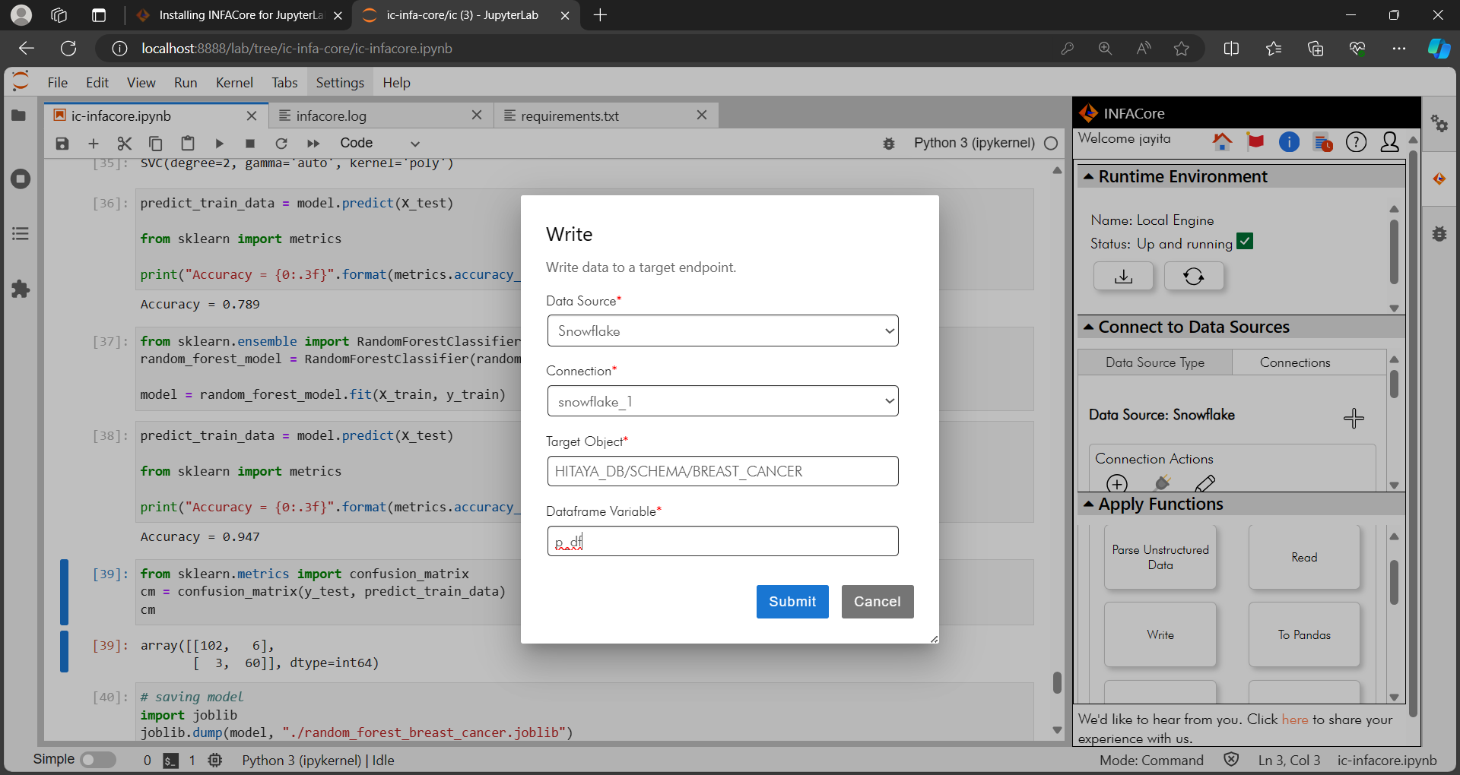
INFACore to access data from diverse data sources, explore data, apply functions, transform the data, and deliver quality data to your business.
INFACore SDK for Python.
JupyterLab extension for INFACore.
Leveraging above tools to build machine learning models for different kinds of disease predictions by injecting data from flat files and saving transformations/predictions to Snowflake database.

Slide 14

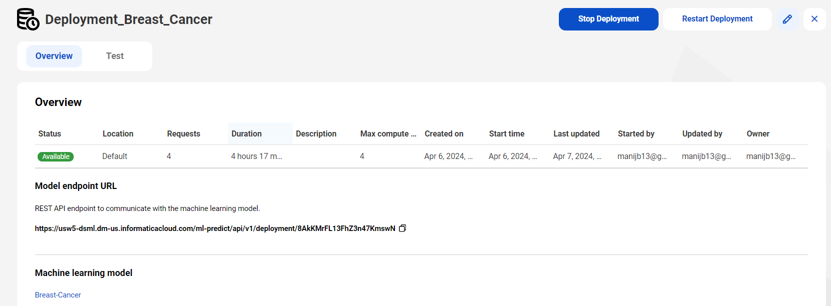
Simplifying MLOps with Informatica ModelServe.
Model Serve to deploy machine learning models and generate predictions based on historical data.
Monitor, alert and consume served AI/ML models in applications.

Slide 15

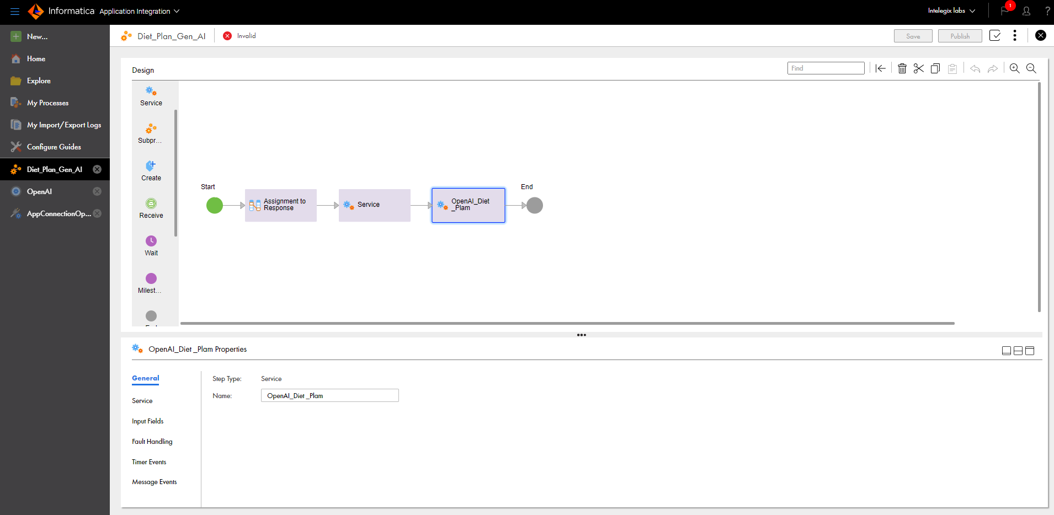
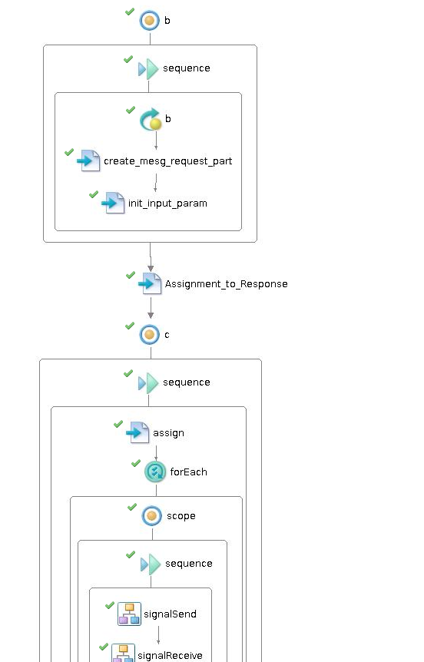
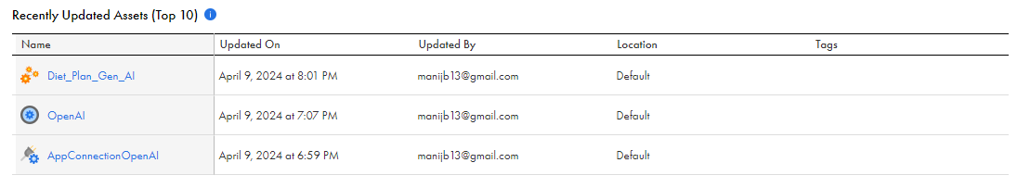
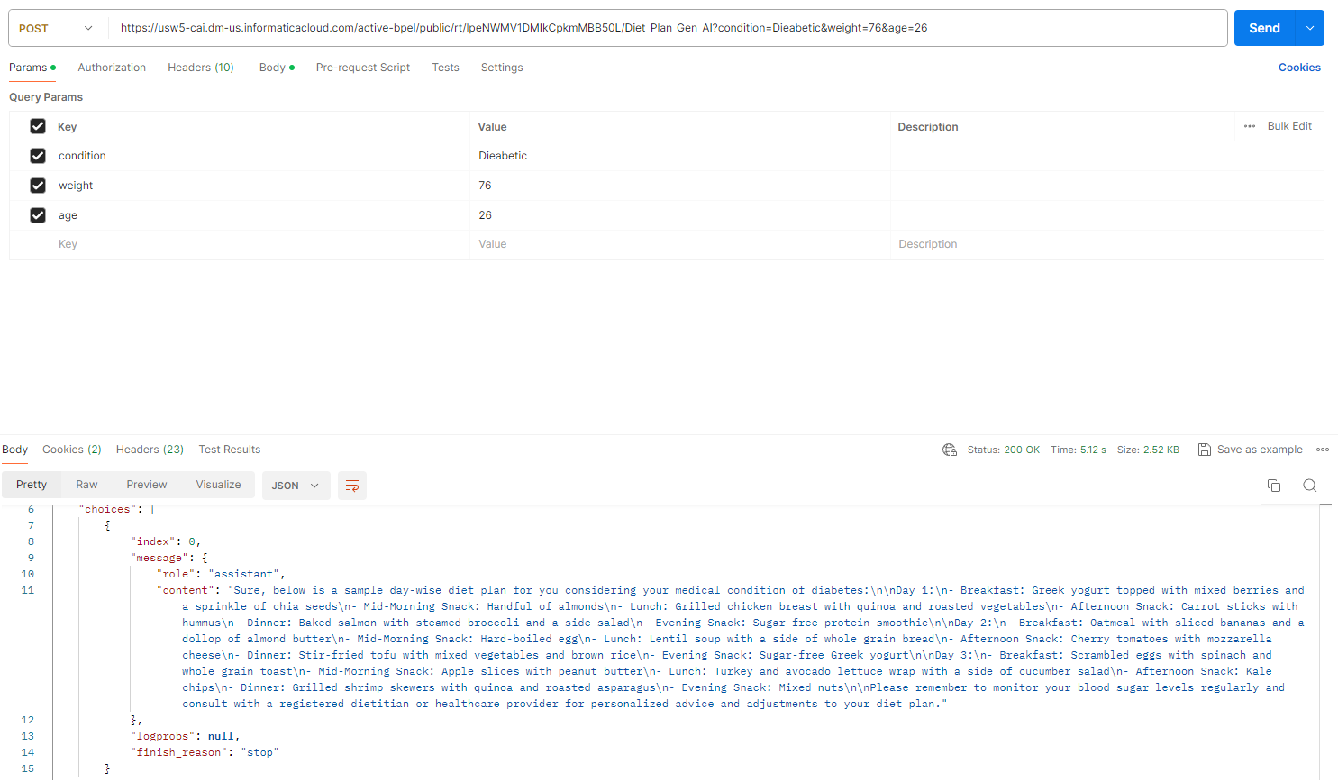
React App is calling Application Integration published API, to get the diet plans.
Service Connector using Form: Connect to OpenAI Rest endpoint, sending age, weight and health condition and prompt template as to fetch the ChatGPT response with a Day wise Diet plan.
App Connection: perform actions to connect our process to a service connector .

Slide 16
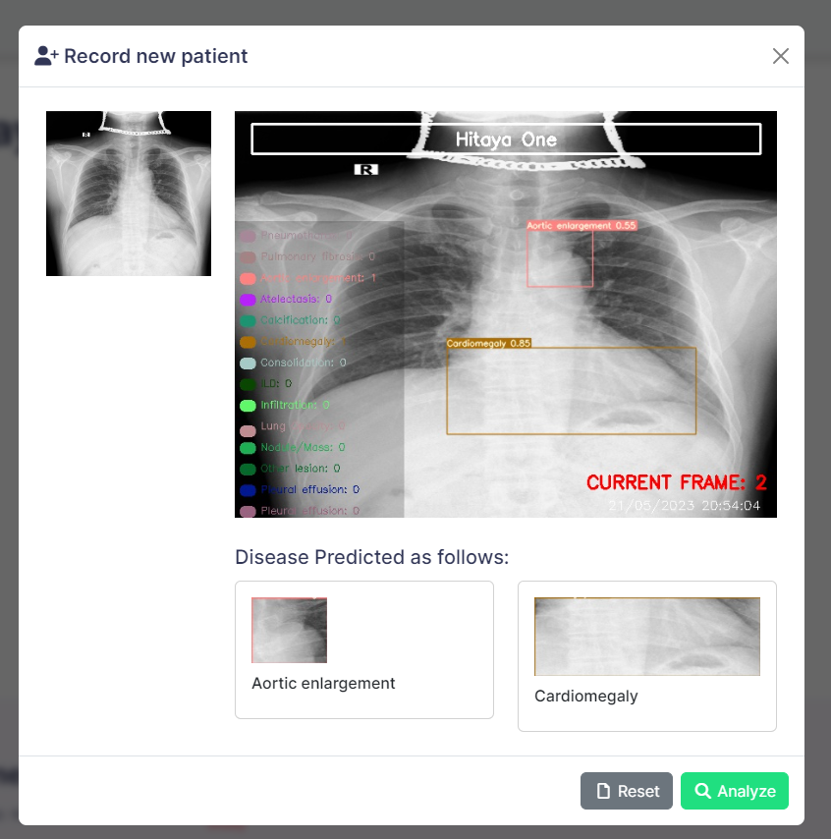
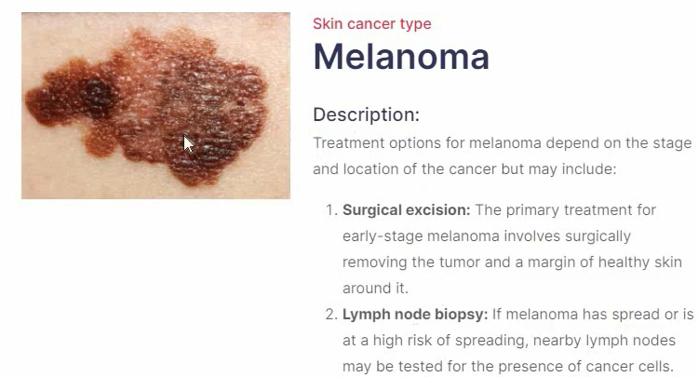
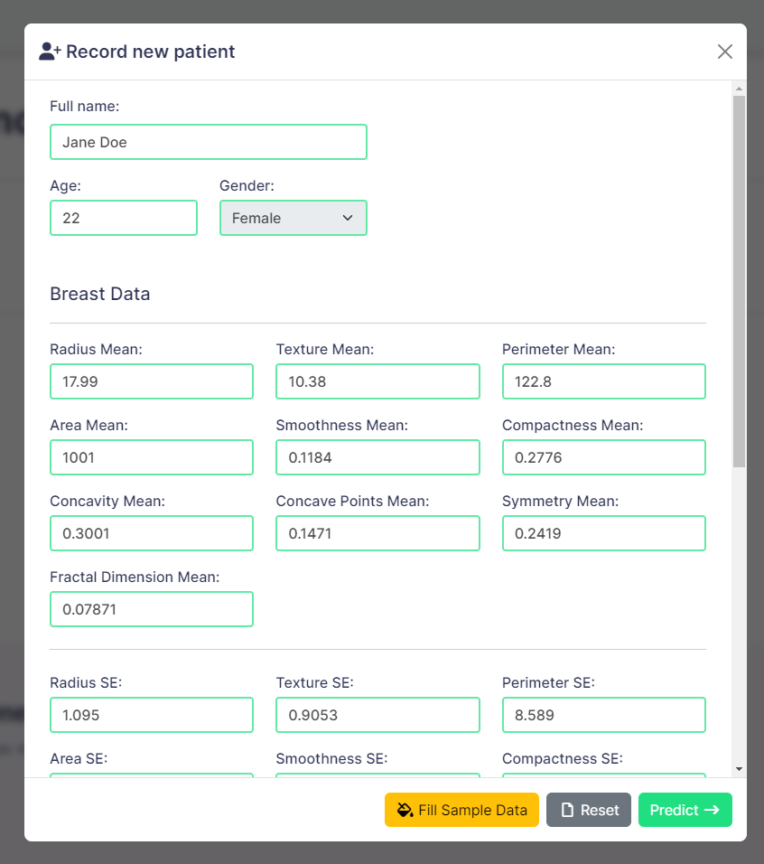
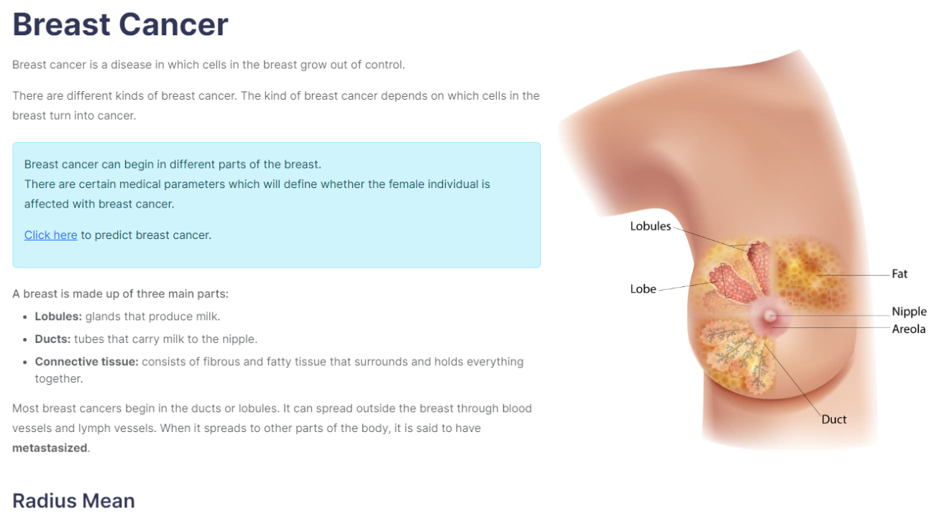
ML Diagnosis System
Hitaya is a one-stop solution, a medical diagnosis App that can allow users to upload medical data or x-ray scans, and the APP will predict whether a patient has any disease or not.
List of Diseases it can predict now
Breast Cancer
Chronic Kidney Disease
Diabetics
Heart Disease
Liver Disease
Chest X-ray Scans
Skin Cancer
Pneumonia X-Ray

Slide 17
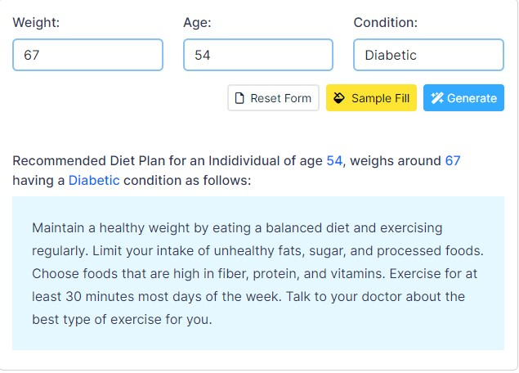
Diet Plans
Use of GenAI to generate health plans, diet tips, exercise routine customized according to user input received, as per user’s health report.

Slide 18


Resources
https://www.youtube.com/watch?v=H3Yu-IWIo1E
https://github.com/IntelegixLabs/Informatica

Slide 19


